Slide 1
The course of
“Nonlinear Control Systems”
Prof. Igor Furtat

Slide 2
The main reference:
H.K. Khalil. Nonlinear Systems

Slide 3
Lab 1
Introduction to nonlinear systems
Solutions of nonlinear systems

Slide 4
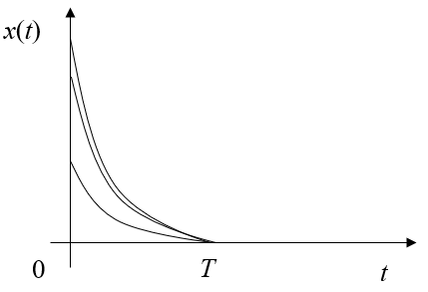
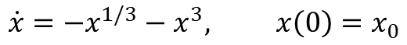
Example 4 (Lecture 1)
Consider the scalar nonlinear system
$$\dot{x}={−x}^{1/3}−x^{3}, x\left(0\right)=x_{0}$$
Properties:
No unique solution
Convergence at finite time T

Slide 5
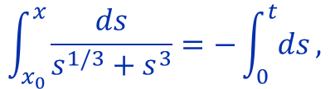
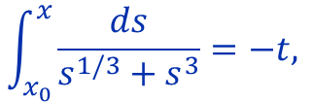
Example 4 (Lecture 1)
Consider the scalar nonlinear system
$$\dot{x}={−x}^{1/3}−x^{3}, x\left(0\right)=x_{0}$$
$$\int_{x_{0}}^{x}{\frac{ds}{s^{1/3}+s^{3}}}=−\int_{0}^{t}{ds},$$
$$\int_{x_{0}}^{x}{\frac{ds}{s^{1/3}+s^{3}}}=−t,$$

Slide 6
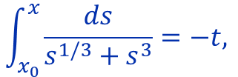
Example 4 (Lecture 1)
Consider the scalar nonlinear system
$$\dot{x}={−x}^{1/3}−x^{3}, x\left(0\right)=x_{0}$$
$$\int_{x_{0}}^{x}{\frac{ds}{s^{1/3}+s^{3}}}=−\int_{0}^{t}{ds},$$
$$\int_{x_{0}}^{x}{\frac{ds}{s^{1/3}+s^{3}}}=−t,$$
$$s^{1/3}=y, s=y^{3}, ds=3y^{2}dy$$

Slide 7
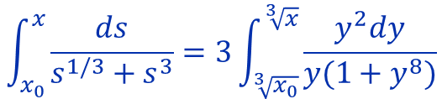
Example 4 (Lecture 1)
Consider the scalar nonlinear system
$$\dot{x}={−x}^{1/3}−x^{3}, x\left(0\right)=x_{0}$$
$$\int_{x_{0}}^{x}{\frac{ds}{s^{1/3}+s^{3}}}=−\int_{0}^{t}{ds},$$
$$\int_{x_{0}}^{x}{\frac{ds}{s^{1/3}+s^{3}}}=−t,$$
$$s^{1/3}=y, s=y^{3}, ds=3y^{2}dy$$
$$\int_{x_{0}}^{x}{\frac{ds}{s^{1/3}+s^{3}}}=3\int_{\sqrt[3]{x_{0}}}^{\sqrt[3]{x}}{\frac{y^{2}dy}{y(1+y^{8})}}$$

Slide 8
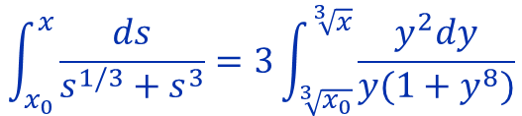
Example 4 (Lecture 1)
$$\int_{x_{0}}^{x}{\frac{ds}{s^{1/3}+s^{3}}}=3\int_{\sqrt[3]{x_{0}}}^{\sqrt[3]{x}}{\frac{y^{2}dy}{y(1+y^{8})}}$$
$$1+y^{8}={(y}^{8}+2y^{4}+1)−2y^{4}={\left(y^{4}+1\right)}^{2}−2y^{4}=(y^{4}+1−\sqrt{2}y^{2})(y^{4}+1+\sqrt{2}y^{2})$$

Slide 9
Example 4 (Lecture 1)
$$\int_{x_{0}}^{x}{\frac{ds}{s^{1/3}+s^{3}}}=3\int_{\sqrt[3]{x_{0}}}^{\sqrt[3]{x}}{\frac{y^{2}dy}{y(1+y^{8})}}$$
$$1+y^{8}={(y}^{8}+2y^{4}+1)−2y^{4}={\left(y^{4}+1\right)}^{2}−2y^{4}=\left(y^{4}+1−\sqrt{2}y^{2}\right)\left(y^{4}+1+\sqrt{2}y^{2}\right)=$$
$$=\left[y^{4}+2y^{2}+1−\left(2+\sqrt{2}\right)y^{2}\right][y^{4}+2y^{2}+1−(2−\sqrt{2})y^{2}]$$

Slide 10
Example 4 (Lecture 1)
$$\int_{x_{0}}^{x}{\frac{ds}{s^{1/3}+s^{3}}}=3\int_{\sqrt[3]{x_{0}}}^{\sqrt[3]{x}}{\frac{y^{2}dy}{y(1+y^{8})}}$$
$$1+y^{8}={(y}^{8}+2y^{4}+1)−2y^{4}={\left(y^{4}+1\right)}^{2}−2y^{4}=\left(y^{4}+1−\sqrt{2}y^{2}\right)\left(y^{4}+1+\sqrt{2}y^{2}\right)=$$
$=\left[y^{4}+2y^{2}+1−\left(2+\sqrt{2}\right)y^{2}\right][y^{4}+2y^{2}+1−(2−\sqrt{2})y^{2}]$=
$=\left[{\left(y^{2}+1\right)}^{2}−\left(2+\sqrt{2}\right)y^{2}\right][{\left(y^{2}+1\right)}^{2}−(2−\sqrt{2})y^{2}]$=
$$=\left[y^{2}+1−\sqrt{2+√2}y\right]\left[y^{2}+1+\sqrt{2+√2}y\right]\left[y^{2}+1−\sqrt{2−√2}y\right]\left[y^{2}+1+\sqrt{2−√2}y\right]$$

Slide 11
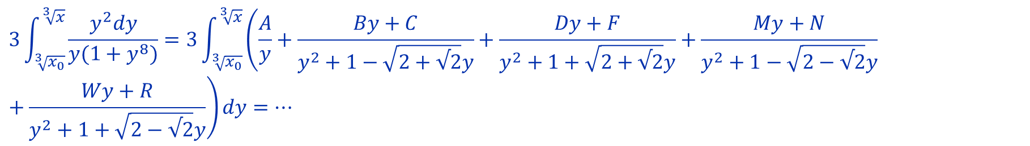
Example 4 (Lecture 1)
$$\int_{x_{0}}^{x}{\frac{ds}{s^{1/3}+s^{3}}}=3\int_{\sqrt[3]{x_{0}}}^{\sqrt[3]{x}}{\frac{y^{2}dy}{y(1+y^{8})}}$$
$$1+y^{8}=\left[y^{2}+1−\sqrt{2+√2}y\right]\left[y^{2}+1+\sqrt{2+√2}y\right]\left[y^{2}+1−\sqrt{2−√2}y\right]\left[y^{2}+1+\sqrt{2−√2}y\right]$$
$$D=2+\sqrt{2}−4=\sqrt{2}−2<0$$
$$3\int_{\sqrt[3]{x_{0}}}^{\sqrt[3]{x}}{\frac{y^{2}dy}{y(1+y^{8})}=3\int_{\sqrt[3]{x_{0}}}^{\sqrt[3]{x}}{\left(\frac{A}{y}+\frac{By+C}{y^{2}+1−\sqrt{2+√2}y}+\frac{Dy+F}{y^{2}+1+\sqrt{2+√2}y}+\frac{My+N}{y^{2}+1−\sqrt{2−√2}y}+\frac{Wy+R}{y^{2}+1+\sqrt{2−√2}y}\right)dy=…}}$$

Slide 12
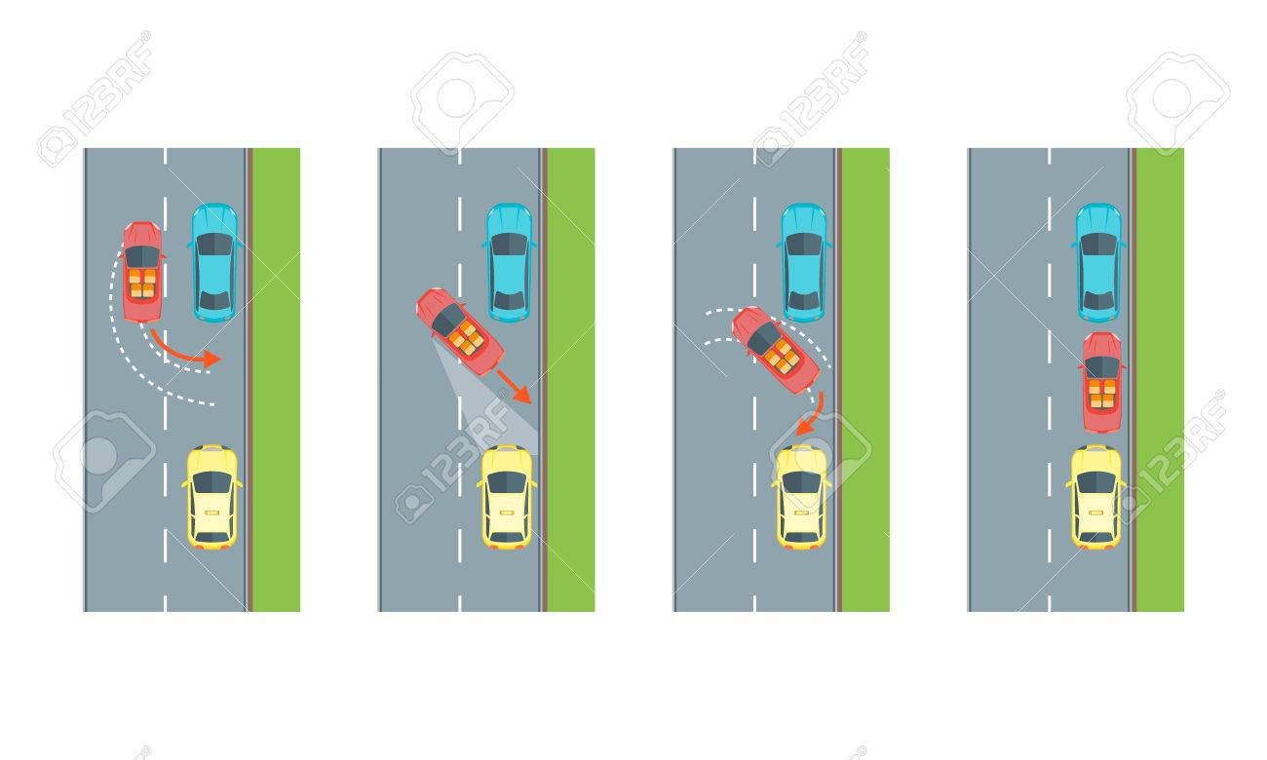
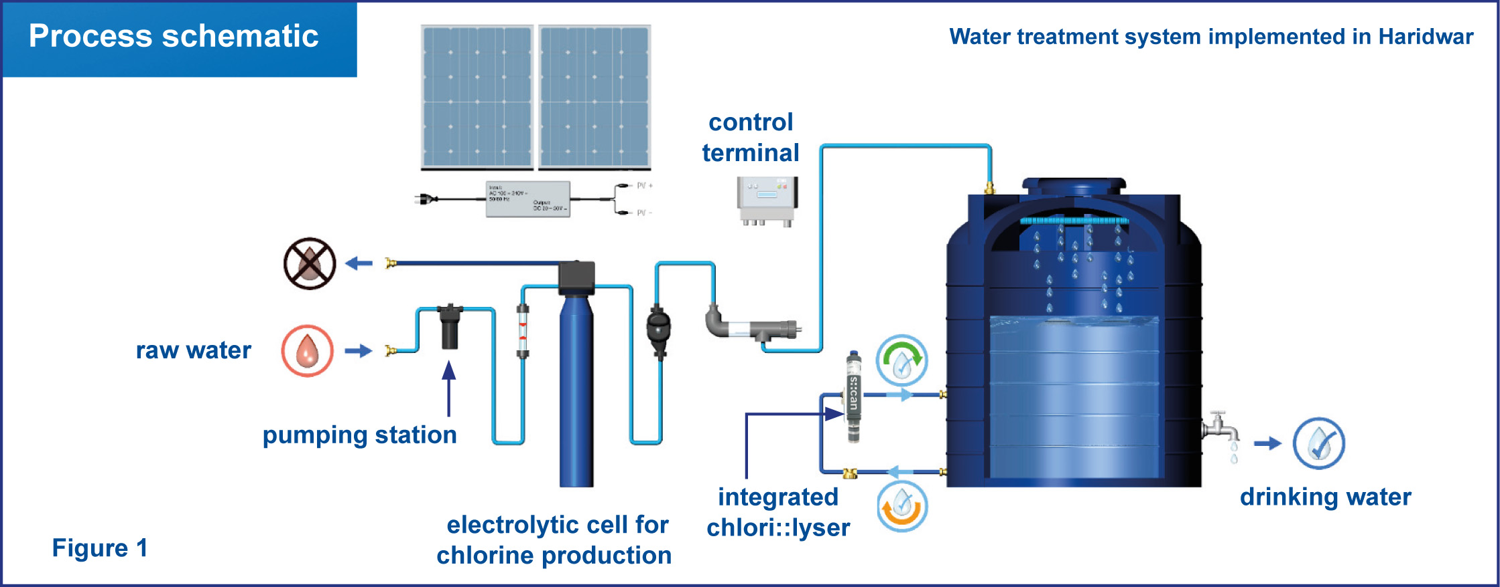
Example 1
Consider the system with control
$\dot{x}=u,$ $x\left(0\right)=x_{0}$
where $x∈R$

Slide 13

Example 1
Consider the system with control
$\dot{x}=u, u=−x^{2}$, $x\left(0\right)=x_{0}$
where $x∈R$

Slide 14

Example 1
Find the solution
$\dot{x}=−x^{2}$, $x\left(0\right)=x_{0}$
where $x∈R$

Slide 15
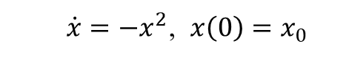

Example 1
Find the solution of
$\dot{x}=−x^{2}$, $x\left(0\right)=x_{0}$
where $x∈R$
The solution is
$$x\left(t\right)=\frac{x_{0}}{1+x_{0}t}$$
Find the transients

Slide 16
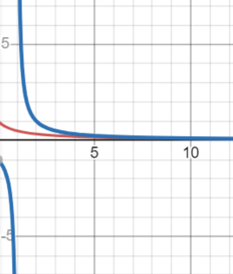
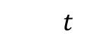
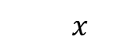
Example 1
Find the solution of
$\dot{x}=−x^{2}$, $x\left(0\right)=x_{0}$
where $x∈R$
$$x$$
The solution is
$$x\left(t\right)=\frac{x_{0}}{1+x_{0}t}$$
$$t$$
The transients

Slide 17

Example 2
Find the solution of
$\dot{x}=u, u=sign x$, $x\left(0\right)=x_{0}$
where $x∈R$

Slide 18
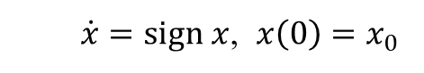

Example 2
Find the solution of
$\dot{x}=sign x$, $x\left(0\right)=x_{0}$
where $x∈R$
The solution is
$$x\left(t\right)=x_{0}+(sign x_{0})t$$
Find the transients

Slide 19
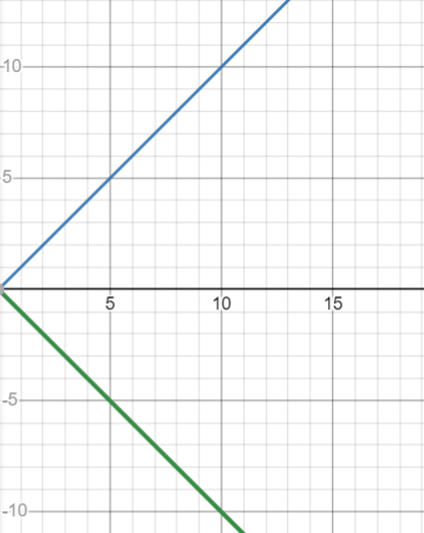

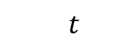
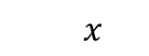
Example 2
Find the solution of
$\dot{x}=sign x$, $x\left(0\right)=x_{0}$
$$x$$
where $x∈R$
The solution is
$$x\left(t\right)=x_{0}+(sign x_{0})t$$
$$t$$
The transients
$$x\left(t\right)=\left\{\begin{aligned}t \\ 0 \\ −t\end{aligned}\right.$$

Slide 20

Example 3
Find the solution of
$\dot{x}=u, u=−sign x$, $x\left(0\right)=x_{0}$
where $x∈R$

Slide 21
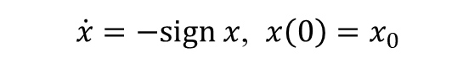

Example 3
Find the solution of
$\dot{x}=−sign x$, $x\left(0\right)=x_{0}$
where $x∈R$
The solution is
$$x\left(t\right)=x_{0}−(sign x_{0})t$$
Find the transients

Slide 22
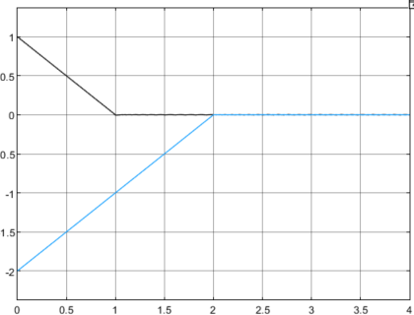
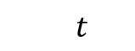
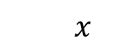
Example 3
Find the solution of
$\dot{x}=−sign x$, $x\left(0\right)=x_{0}$
$$x$$
where $x∈R$
The solution is
$$x\left(t\right)=x_{0}−(sign x_{0})t$$
Find the transients
$$t$$

Slide 23
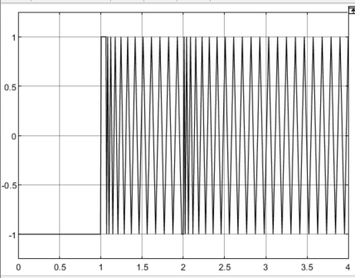
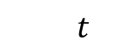
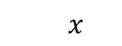
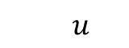
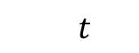
Example 3
$$u$$
Find the solution of
$\dot{x}=−sign x$, $x\left(0\right)=x_{0}$
where $x∈R$
The solution is
$$t$$
$$x\left(t\right)=x_{0}−(sign x_{0})t$$
$$x$$
Find the transients
$$t$$

Slide 24
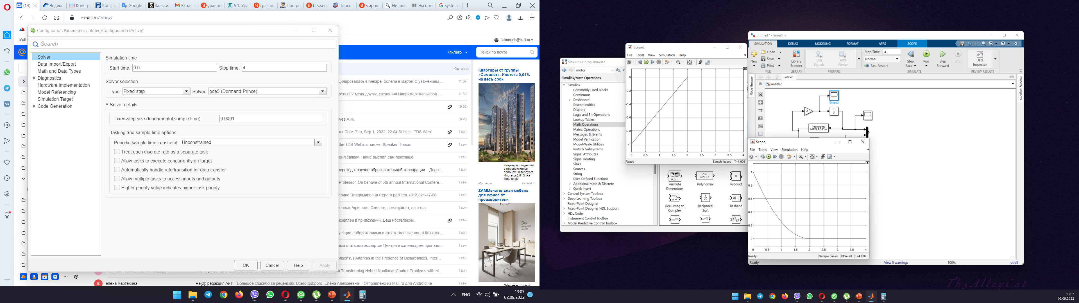
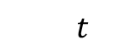
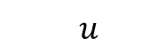
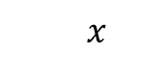
Example 4 (from lecture)
$$u$$
Consider the scalar nonlinear system
$$\dot{x}={u, u=−x}^{1/3}, x\left(0\right)=x_{0}$$
$$t$$
$$x$$
Properties:
No unique solution
Convergence at finite time T
$$t$$

Slide 25
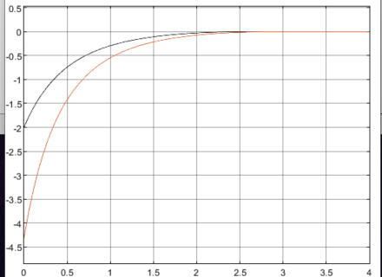
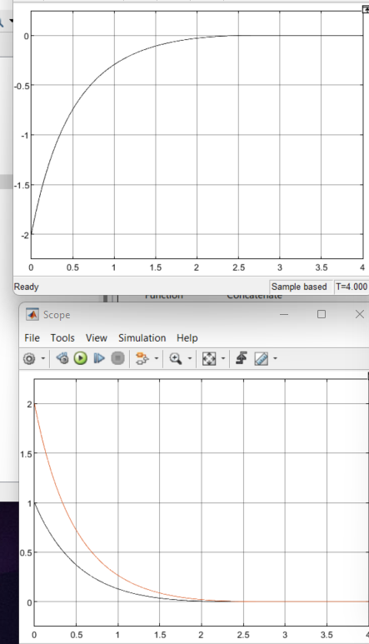
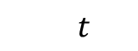
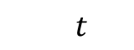
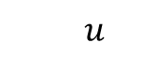
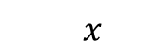
Example 5 (from lecture)
Consider the scalar nonlinear system
$$u$$
$$\dot{x}={u, u=−x}^{1/3}−x^{3}, x\left(0\right)=x_{0}$$
$$t$$
$$x$$
Properties:
No unique solution
Convergence at finite time T
$$t$$

Slide 26

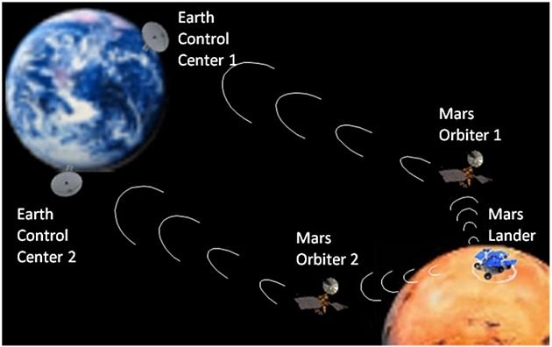
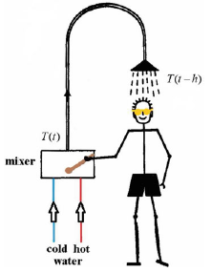
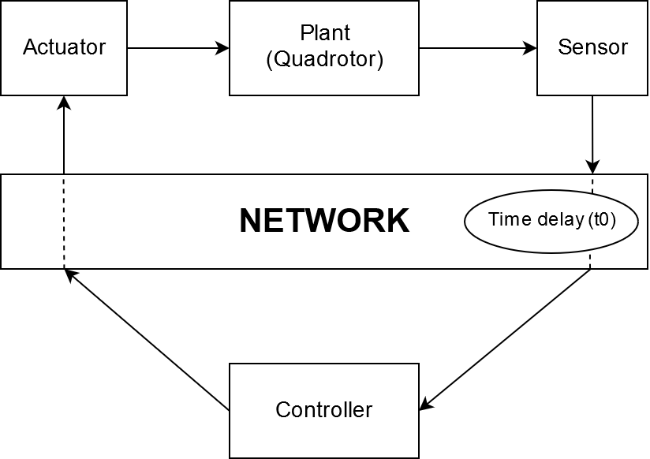
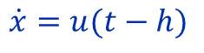
Example 6
Consider the system
$$\dot{x}=u(t−h)$$

Slide 27
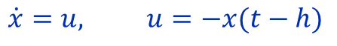
Example 6
Consider the system
$$\dot{x}=u, u=−x(t−h)$$
How to set initial conditions?

Slide 28
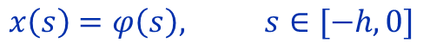
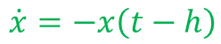
Example 6
Consider the system
$$\dot{x}=u, u=−x\left(t−h\right), h>0 is a time delay$$
Initial condition
$$x\left(s\right)=φ\left(s\right), s∈[−h,0]$$
Find the solutions of
$$\dot{x}=−x\left(t−h\right)$$

Slide 29
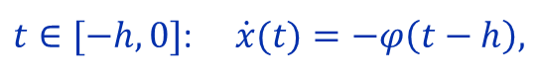
Example 6
Consider the system
$$\dot{x}=u, u=−x\left(t−h\right), h>0 is a time delay$$
Initial condition
$$x\left(s\right)=φ\left(s\right), s∈[−h,0]$$
The solutions are found by use the step method initiated by Bellman
$t∈[−h,0]$: $\dot{x}(t)=−φ\left(t−h\right),$
Then we continue this procedure for $t∈[h,2h]$, $t∈[2h,3h]$…

Slide 30
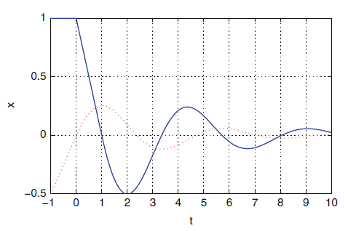
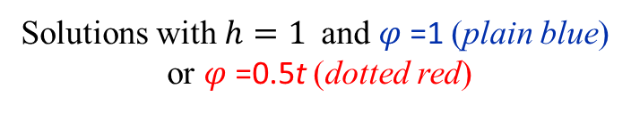
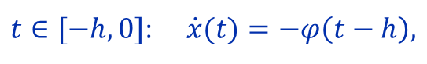
Example 6
Consider the system
$$\dot{x}=u, u=−x\left(t−h\right), h>0 is a time delay$$
Initial condition
$$x\left(s\right)=φ\left(s\right), s∈[−h,0]$$
Solutions with $h=1$and $φ$=1 (plain blue)
or $φ$=0.5t (dotted red)
The solutions are found by use the step method initiated by Bellman
$t∈[−h,0]$: $\dot{x}(t)=−φ\left(t−h\right),$
Then we continue this procedure for $t∈[h,2h]$, $t∈[2h,3h]$…

Slide 31

Example 7
Consider the system
$$\dot{x}=bu$$
where b is an unknown coefficient.
It is necessary to find a control law u that ensures the system stabilization (5 min).

Slide 32
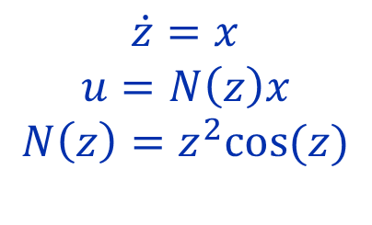
Example 7
Consider the system
$$\dot{x}=bu$$
where b is an unknown coefficient.
Nassbaum coefficient
$$\dot{z}=x$$
$$u=N\left(z\right)x$$
$$N\left(z\right)=z^{2}cos⁡(z)$$
Draw the transients (5 min)

Slide 33
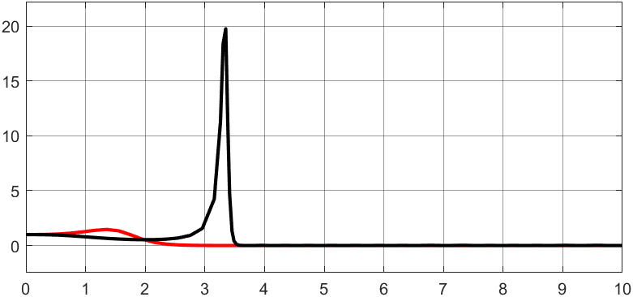




Example 7
Consider the system
$$\dot{x}=bu$$
where b is an unknown coefficient.
Nassbaum coefficient
$$b=1,−1$$
$$\dot{z}=x$$
$$u=N\left(z\right)x$$
$$N\left(z\right)=z^{2}cos⁡(z)$$
$$x$$
$$t$$

Slide 34

Example 8
Consider the system
$$\dot{x}=ax+bu$$
where a and b are unknown coefficients.
It is necessary to find a control law u that ensures the system stabilization (5 min).

Slide 35

Example 8
Consider the system
$$\dot{x}=ax+bu$$
where b is an unknown coefficient.
Nassbaum coefficient
$$\dot{z}=x$$
$$u=N\left(z\right)x$$
$$N\left(z\right)=z^{2}cos⁡(z)$$
Draw the transients (5 min)

Slide 36



Example 8
Consider the system
$$\dot{x}=ax+bu$$
where b is an unknown coefficient.
Nassbaum coefficient
$$a=1 and b=1,−1$$
$$\dot{z}=x$$
$$u=N\left(z\right)x$$
$$N\left(z\right)=z^{2}cos⁡(z)$$
$$x$$
$$t$$

Slide 37
Lab 1
Introduction to nonlinear systems
Phase portrait of nonlinear systems

Slide 38
Example 1
State-space equation
Find equilibrium points

Slide 39
Example 1
State-space equation
Equilibrium points (0;0), (1;-1) and (-1;1)
Find Jacobian matrix (Jacobian)

Slide 40
Example 1
State-space equation
Equilibrium points (0;0), (1;-1) and (-1;1)
Jacobian matrix
Find Jacobian at equilibrium points

Slide 41

Example 1
State-space equation
Equilibrium points (0;0), (1;-1) and (-1;1)
Jacobian matrix
Find Jacobian at equilibrium points
$$A_{1}=\left[\begin{matrix}−1 & 1 \\ −1 & −1\end{matrix}\right], \text{eigenvalues}\text{: }−1±j \\ A_{2}=A_{3}=\left[\begin{matrix}5 & 1 \\ −1 & −1\end{matrix}\right], \text{eigenvalues}\text{: }−0.8284 \text{and}\text{ 4.8284}$$
What kind of equilibrium points (0;0), (1;-1) and (-1;1)?

Slide 42
Example 1
State-space equation
Equilibrium points (0;0), (1;-1) and (-1;1)
Jacobian matrix
Find Jacobian at equilibrium points
$$A_{1}=\left[\begin{matrix}−1 & 1 \\ −1 & −1\end{matrix}\right], \text{eigenvalues}\text{: }−1±j \\ A_{2}=A_{3}=\left[\begin{matrix}5 & 1 \\ −1 & −1\end{matrix}\right], \text{eigenvalues}\text{: }−0.8284 \text{and}\text{ 4.8284}$$
Equilibrium point (0;0) is a stable focus,
Equilibrium points (1;-1) and (-1;1) are saddles
Draw the phase portrait of the system

Slide 43

Example 1
Phase portrait of the system

Slide 44
Example 2
State-space equation
Find equilibrium points

Slide 45
Example 2
State-space equation
Equilibrium points (0;0), (0;1) and (1;-1)
Find Jacobian matrix

Slide 46
Example 2
State-space equation
Equilibrium points (0;0), (0;1) and (1;-1)
Jacobian matrix
Find Jacobian at equilibrium points

Slide 47

What kind of equilibrium points (0;0), (0; 1) and (-1;1)?
State-space equation
Equilibrium points (0;0), (0;1) and (1;-1)
Jacobian matrix
Jacobian at equilibrium points
$$A_{1}=\left[\begin{matrix}1 & 0 \\ 0 & −1\end{matrix}\right], \text{eigenvalues}\text{: }−1 \text{and} 1 \\ A_{2}=\left[\begin{matrix}2 & 0 \\ 1 & 1\end{matrix}\right], \text{eigenvalues}\text{: }1 \text{and}\text{ 2} \\ A_{3}=\left[\begin{matrix}0 & 1 \\ −4 & −2\end{matrix}\right], \text{eigenvalues}\text{: }−1±1.7321j$$

Slide 48

Example 2
State-space equation
Equilibrium points (0;0), (0;1) и (1;-1)
Jacobian matrix
Jacobian at equilibrium points
$$A_{1}=\left[\begin{matrix}1 & 0 \\ 0 & −1\end{matrix}\right], \text{eigenvalues}\text{: }−1 \text{and} 1 \\ A_{2}=\left[\begin{matrix}2 & 0 \\ 1 & 1\end{matrix}\right], \text{eigenvalues}\text{: }1 \text{and}\text{ 2} \\ A_{3}=\left[\begin{matrix}0 & 1 \\ −4 & −2\end{matrix}\right], \text{eigenvalues}\text{: }−1±1.7321j$$
Equilibrium point (0;0) is a saddle, equilibrium point (0;1) is an unstable focus,
Equilibrium point (1;-1) is a stable focus
Draw the phase portrait of the system

Slide 49

Example 2
Phase portrait of the system

Slide 50
Example 3
State-space equation
Find equilibrium point

Slide 51
Example 3
State-space equation
Equilibrium point (0;0)
Find Jacobian

Slide 52
Example 3
State-space equation
Equilibrium point (0;0)
Jacobian
Find Jacobian at equilibrium points

Slide 53

Example 3
State-space equation
Equilibrium point (0;0)
Jacobian
Jacobian at equilibrium points
$$A=\left[\begin{matrix}0 & 1 \\ −1 & 1\end{matrix}\right],\text{eigenvalues}\text{: }0.5±0.866j$$
What kind of equilibrium point (0;0)?

Slide 54
Example 3
State-space equation
Equilibrium point (0;0)
Jacobian
Jacobian at equilibrium points
$$A=\left[\begin{matrix}0 & 1 \\ −1 & 1\end{matrix}\right],\text{eigenvalues}\text{: }0.5±0.866j$$
Equilibrium point (0;0) is an unstable focus

Slide 55
Example 3
State-space equation
Equilibrium point (0;0)
Jacobian
Jacobian at equilibrium points
$$A=\left[\begin{matrix}0 & 1 \\ −1 & 1\end{matrix}\right],\text{eigenvalues}\text{: }0.5±0.866j$$
Equilibrium point (0;0) is an unstable focus
Draw the phase portrait of the system

Slide 56

Example 3
Phase portrait of the system

Slide 57
Example 4
State-space equation
Find equilibrium points

Slide 58
Example 4
State-space equation
Equilibrium point (0;0) and
Find Jacobian

Slide 59
Example 4
State-space equation
Equilibrium point (0;0) and
Jacobian
Find Jacobian at equilibrium points

Slide 60

Example 4
State-space equation
Equilibrium point (0;0) and
Jacobian
Jacobian at equilibrium points
$$A=\left[\begin{matrix}1 & −1 \\ 1 & 1\end{matrix}\right],\text{eigenvalues}\text{: }1±j$$
What kind of equilibrium point (0;0)?

Slide 61
Example 4
State-space equation
Equilibrium points (0;0) and
Jacobian
Jacobian at equilibrium points
$$A=\left[\begin{matrix}1 & −1 \\ 1 & 1\end{matrix}\right],\text{eigenvalues}\text{: }1±j$$
Equilibrium point (0;0) is an unstable focus
Draw the phase portrait of the system

Slide 62

Example 4
Phase portrait of the system

Slide 63
Example 5
State-space equation
Find equilibrium points

Slide 64
Example 5
State-space equation
Equilibrium points (0;0), (1;1) and (-1;-1)
Find Jacobian

Slide 65
Example 5
State-space equation
Equilibrium points (0;0), (1;1) and (-1;-1)
Jacobian
Find Jacobian at equilibrium points

Slide 66

Example 5
State-space equation
Equilibrium points (0;0), (1;1) and (-1;-1)
Jacobian
Jacobian at equilibrium points
$$A_{1}=\left[\begin{matrix}0 & 1 \\ 1 & 0\end{matrix}\right], \text{eigenvalues}\text{: }−1 \text{and} 1 \\ A_{2}=A_{3}=\left[\begin{matrix}−3 & 1 \\ 1 & −3\end{matrix}\right], \text{eigenvalues}\text{: }−4 \text{and} −2$$
What kind of equilibrium points (0;0), (1;1) and (-1;-1)?

Slide 67

Example 5
State-space equation
Equilibrium points (0;0), (1;1) and (-1;-1)
Jacobian
Jacobian at equilibrium points
$$A_{1}=\left[\begin{matrix}0 & 1 \\ 1 & 0\end{matrix}\right], \text{eigenvalues}\text{: }−1 \text{and} 1 \\ A_{2}=A_{3}=\left[\begin{matrix}−3 & 1 \\ 1 & −3\end{matrix}\right], \text{eigenvalues}\text{: }−4 \text{and} −2$$
Equilibrium point (0;0) is a saddle,
Equilibrium points (1;1) and (-1;-1) are stable focuses
Draw the phase portrait of the system

Slide 68

Example 5
Phase portrait of the system

